Slide 1
IMPICIT NEURAL REPRESENTATION
AND
NEURAL RADIANCE FIELDS
LI Chenxin 22042359R 2022-10-11

Slide 2
Outline
Task Definition
Importance --Why Go Implicit?
Existing Attempts In Community
Discussion On Challenges

Slide 3
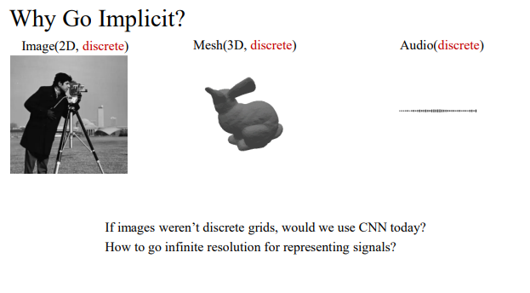
Notes:
Let’s start with a data format which is most similar to us, image.
As we know, Image data is composed in the form of discrete grids.
However, this idea is indeed contradictory to the insight that we gain from our real world.

Slide 4
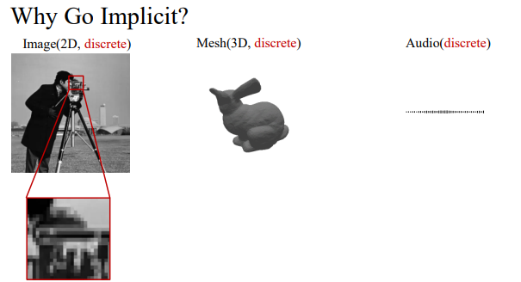
Notes:
That is, in our real world, the signals like Images we feel are continuous, which means that they can be infinitely divisible.
So, in this regard, there is a representation gap between them.
So, a very natural idea is that how can we represent the data we observe in a continuous fashion?

Slide 5
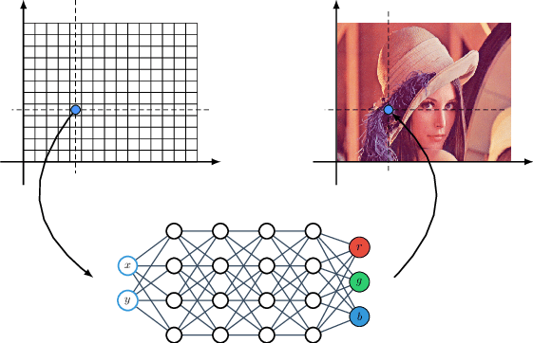
Notes:
So, INR is motivated by this insight.
The input Is the coordinate of pixels, and the output is the corresponding RGB value.
Then, we can use a simple MLP model to represent an image.
Since we can arbitrarily query not only the integral coordinate but also the fractional one so that INR have the protentional to infer the value in any resolution.

Slide 6
Outline
Task Definition
Importance --Why Go Implicit?
Existing Attempts In Community
Discussion On Challenges

Slide 7
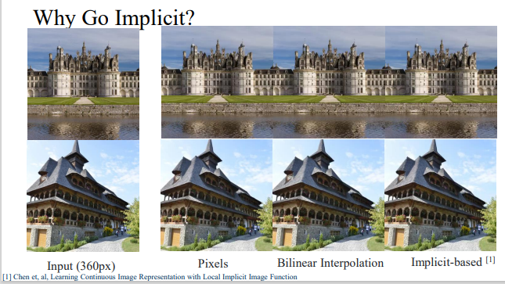
Notes:
So, why go implicit? What can implicit representation bring us?
A very intuitive example is that we can exploit INR for super-resolution in arbitrary resolution. Right?

Slide 8
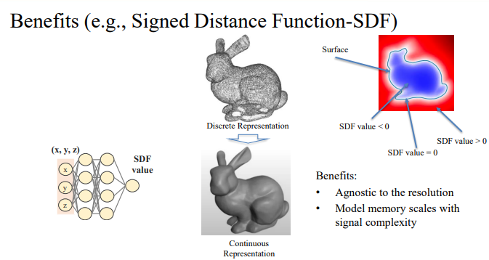
Notes:
And the benefits of using implicit rather than the explicit representation to describe a scene is beyond only high-quality super-resolution.
For example, for a scene of SDF, which contains a very huge data amount if we use an explicit representation, will be well described with only some MLP layers.
So, to this end, the benefits can further summarized as:

Slide 9
Outline
Task Definition
Importance --Why Go Implicit?
Existing Attempts In Community
Discussion On Challenges

Slide 10
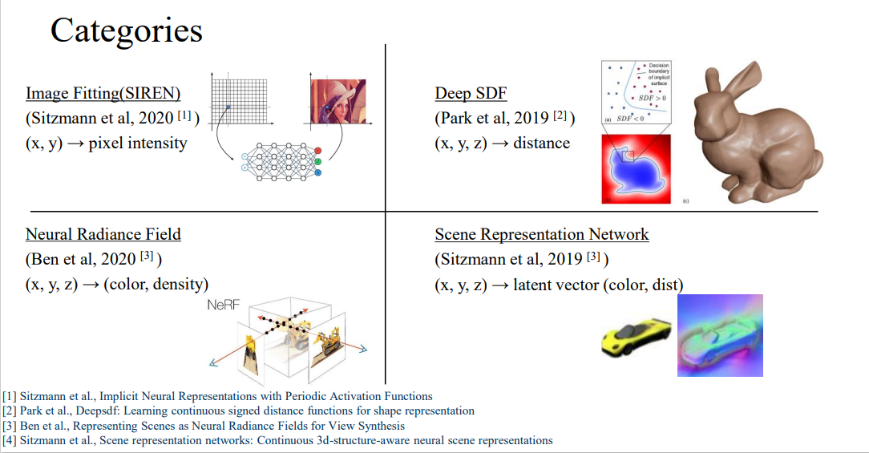
Notes:
Four categories
In fact, the insight can be far beyond these topics.
As long as we can construct a novel pair of input and output, we can define the fancy work which shares the intrinsic core of INR in our own work.

Slide 11
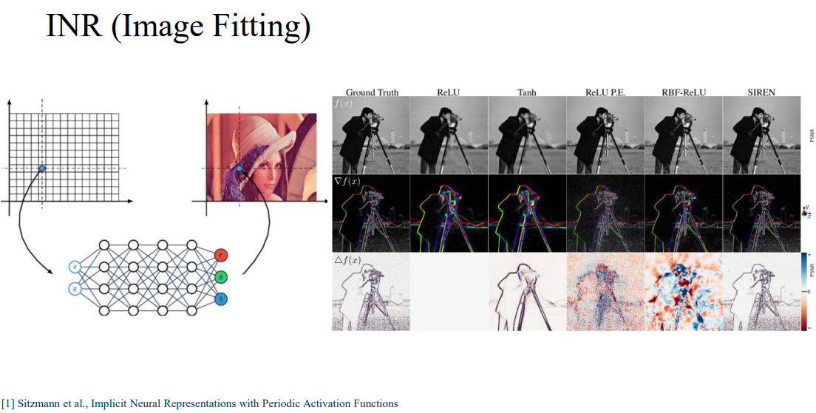
Notes:
For image fitting,
Activation functions.

Slide 12
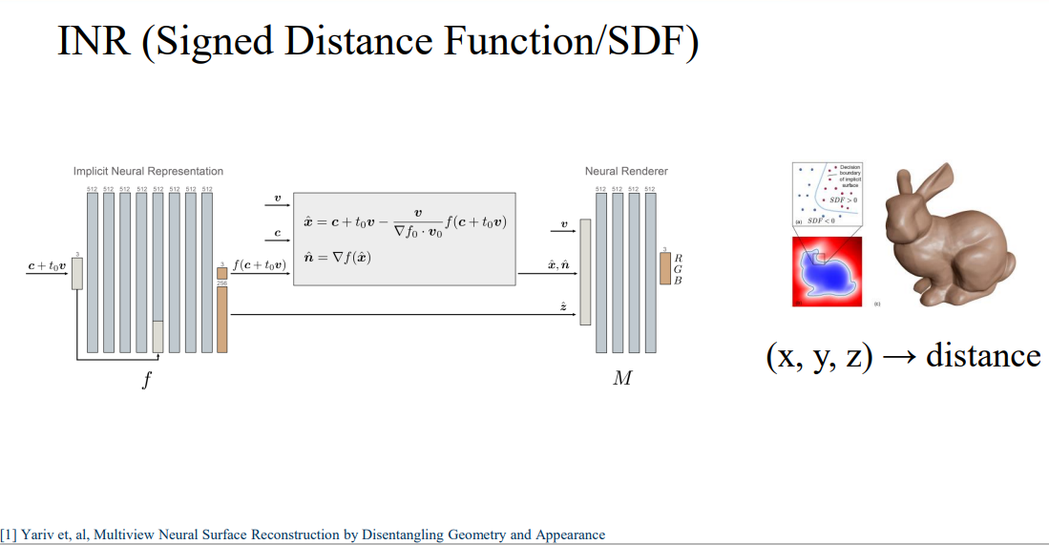
Notes:
For SDF,
Disentangle the geometry and appearance to gain a more controllable representation of a SDF

Slide 13
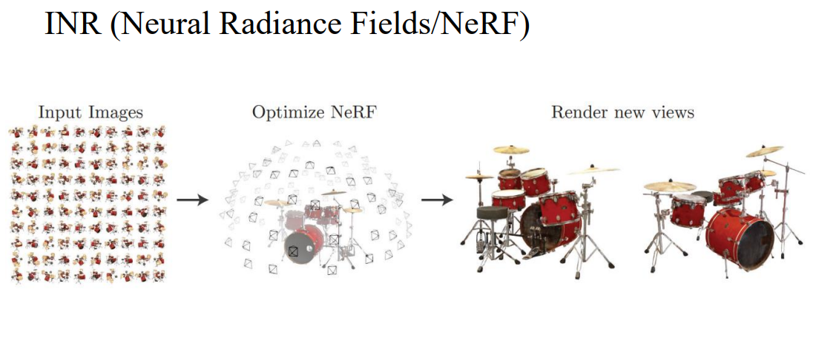
Notes:
A very well-known name, NeRF.
The whole name is
When we train the NERF model with some input views, we want the model to output the novel views that are never seen.

Slide 14
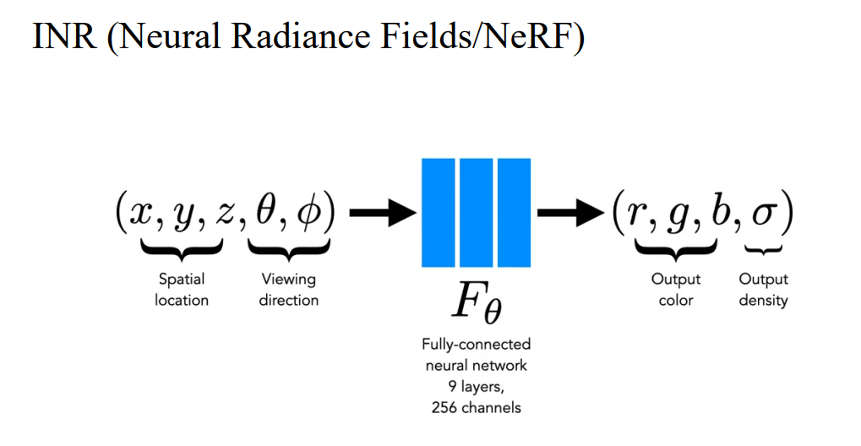
Notes:
Here, specially, I WANT to talk a bit more about Neural Radiance Fields (NeRF), caz it is really an emerging topic in community now.
Sharing the same spirit, we care the input and output of this pipeline, that is…
So, from this viewpoint, it is really simple yet effective

Slide 15
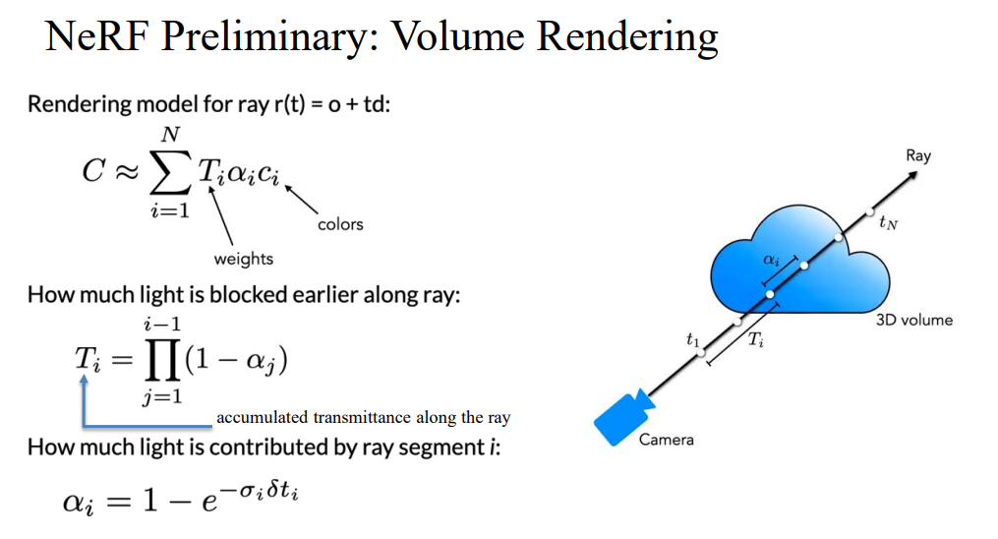
Notes:
However, NeRF also involves some preliminary knowledge about volume rendering, which is an essential concept in Graphics and computational computing.
Here, I don't want to go into too much detail here due to the ten-minute limitation.
We just need to understand that for every pixel we see in an image view, the RGB value we observe is in fact factored and accumulated by the many sampling points in that ray.

Slide 16
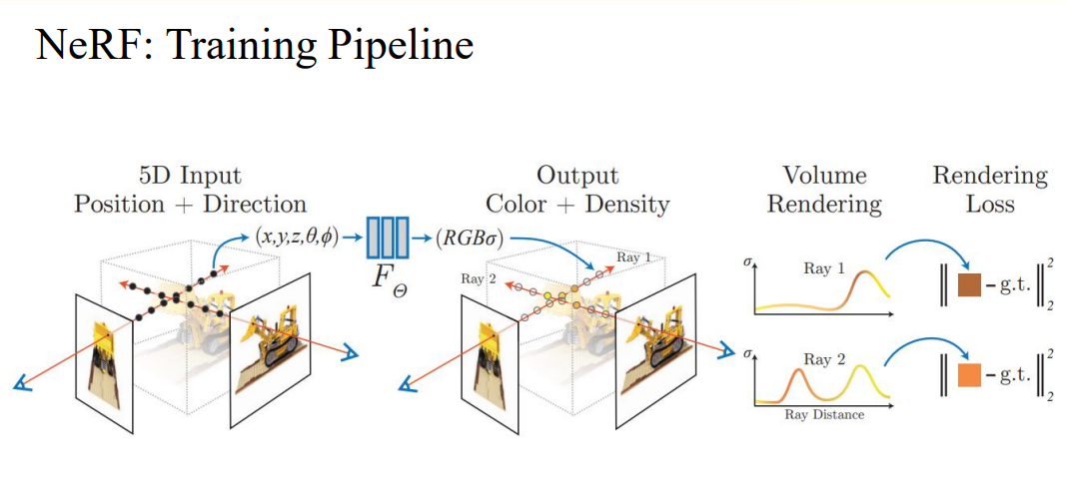
Notes:
The training pipeline is shown here.
MLP + volume rendering
This volume rendering is differential, which ensures an efficient end2end training pipeline.

Slide 17
Outline
Task Definition
Importance --Why Go Implicit?
Existing Attempts In Community
Discussion On Challenges

Slide 18


Conclusion
Implicit Neural Representation (INR), a better continuous representation for small scale object/scene
Agnostic to the resolution
Implicit Neural Representation (INR) typically requires per-scene training, which is not very generalizable
The render procedure is time-consuming (inference per pixel/ray)

Slide 19
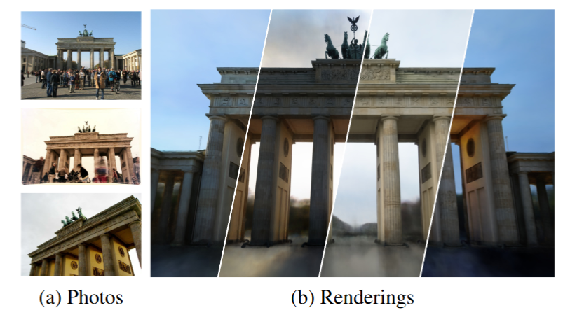
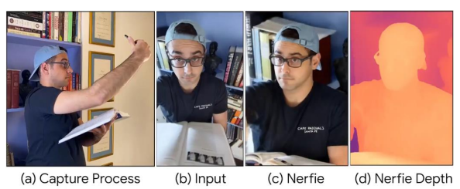
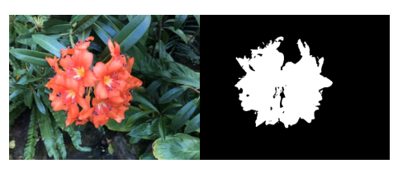
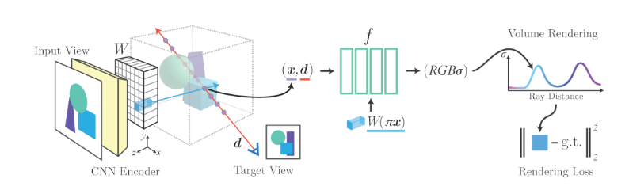
Further Challenges & What’s Next?
NeRF for dynamic scenes (Fig. 1)
NeRF for data in the wild (Fig. 2)
INR with high-level semantic tasks (Fig. 3)
More generalizable INR (Fig. 4)
Fig. 1
Fig. 2
Fig. 3
Fig. 4
Notes:
The basic assumption of NeRF is that the geometry density is consistent across different views, however, …1 & 2

